Slide 1
Supernormal Stimuli
Mihai Toma, Colin Camerer
July 20th, 2022

Slide 2
Agenda
What are supernormal stimuli (SNS), examples in animals
SNS in humans
Peak shift effect
Experiment example
Efficient coding
Way forward

Slide 3
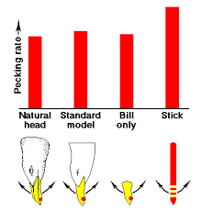
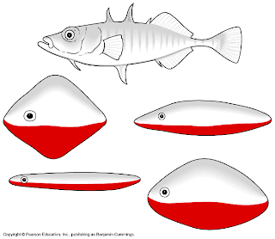
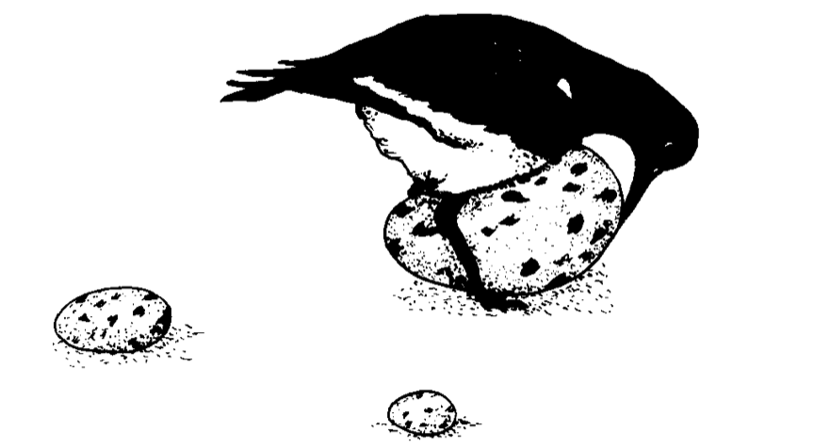
What are supernormal stimuli (1)
Oystercatcher
Stickleback fish
Herring gull
Tinbergen, 1949; Tinbergen & Perdeck 1950; Tinbergen, 1989

Slide 4
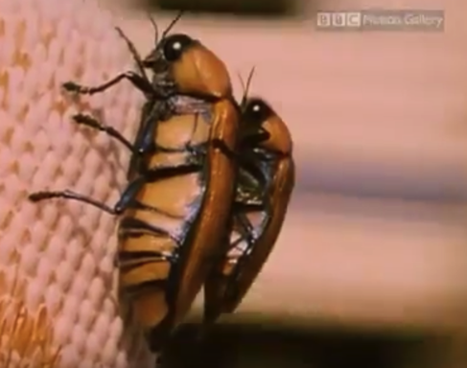
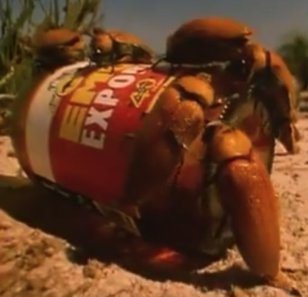
What are supernormal stimuli (2)
https://www.youtube.com/watch?v=t1pOZbytOhE

Slide 5
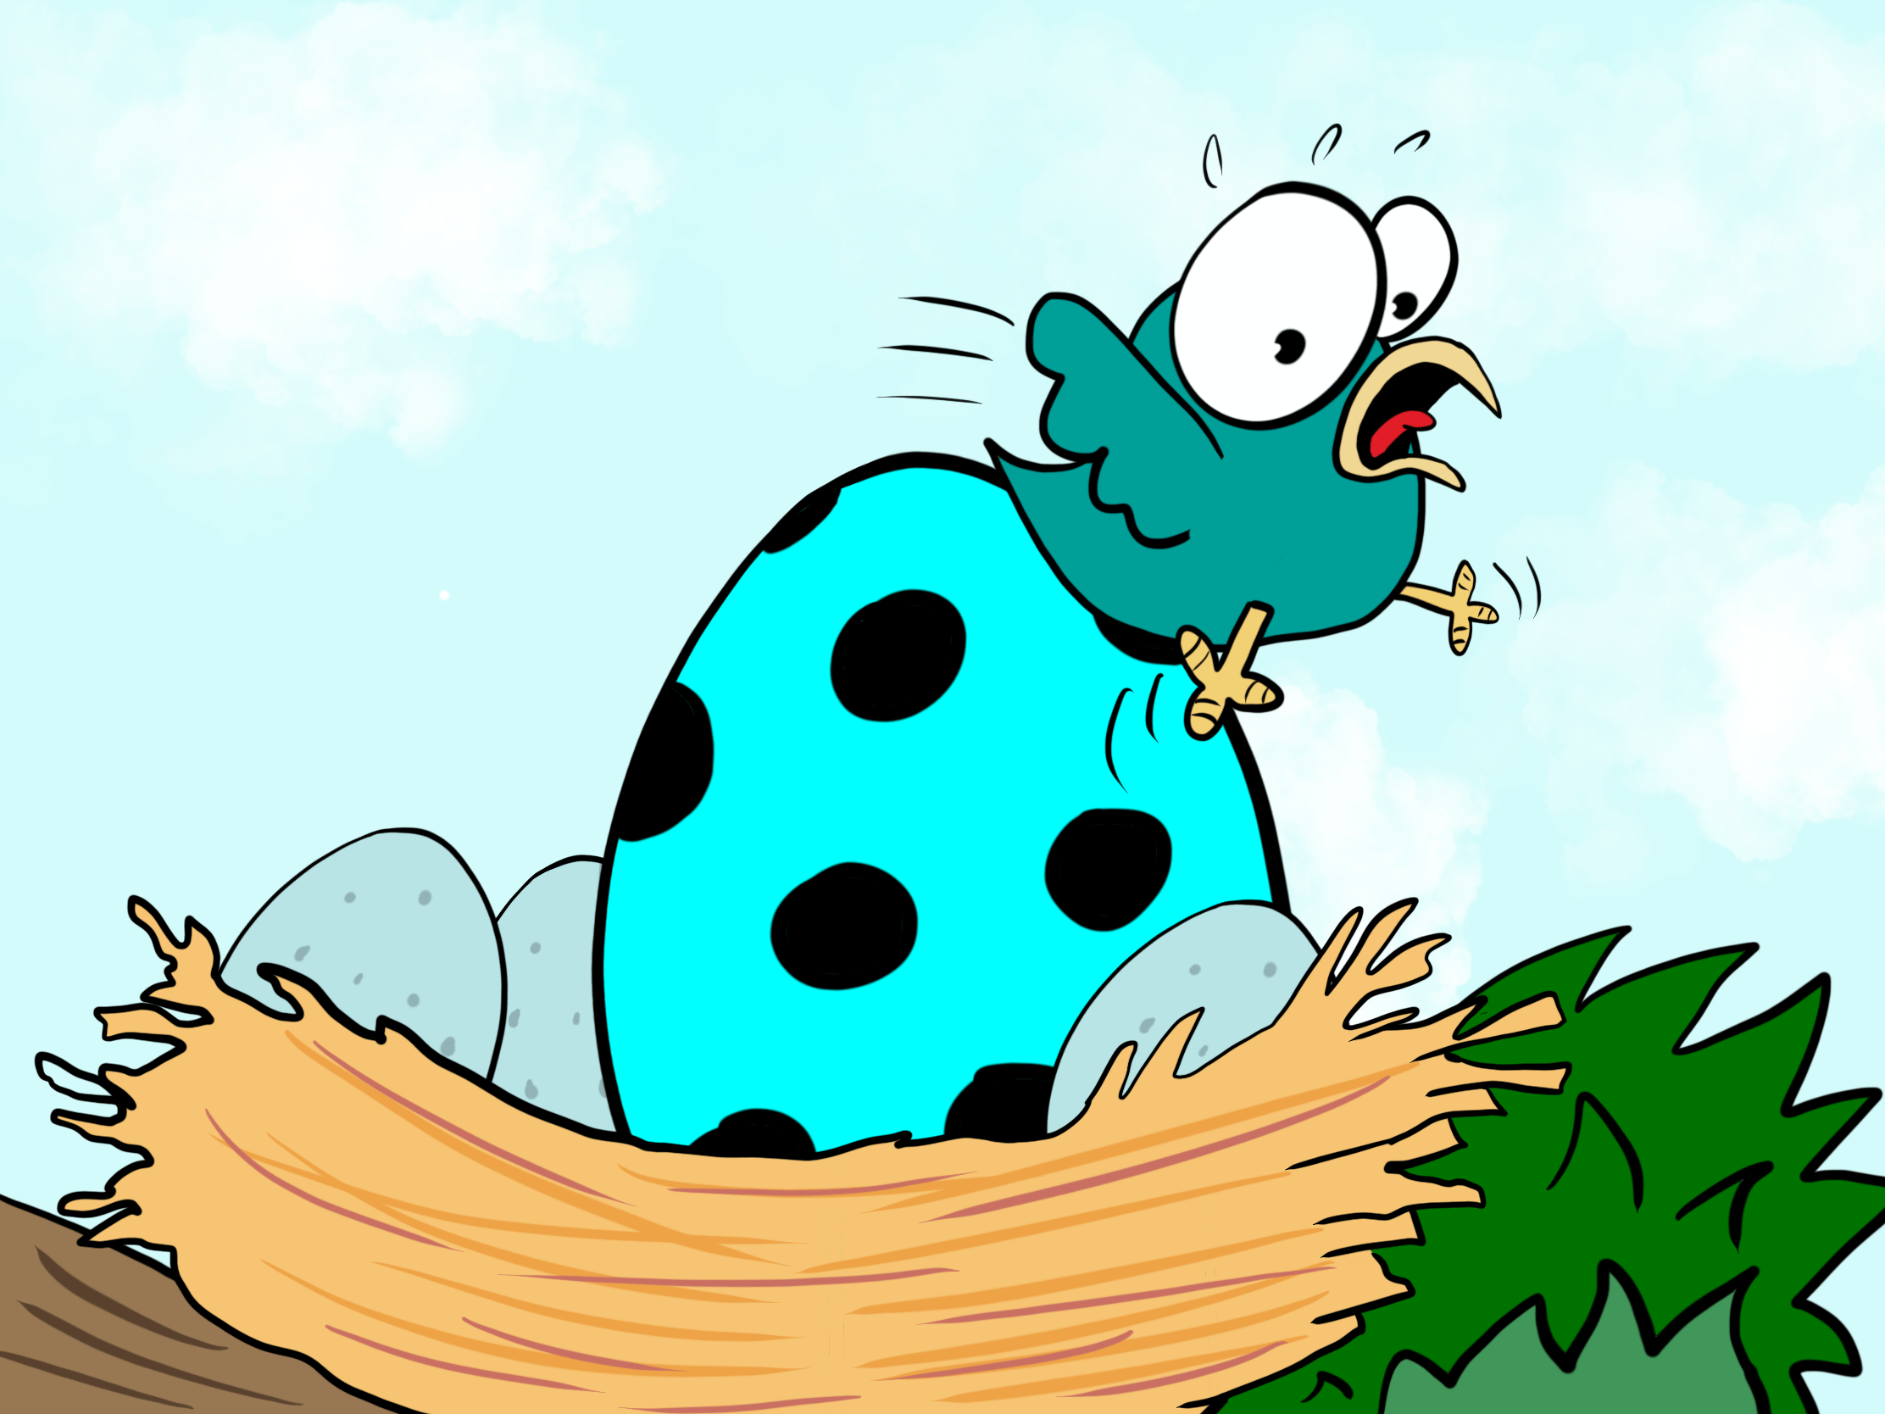
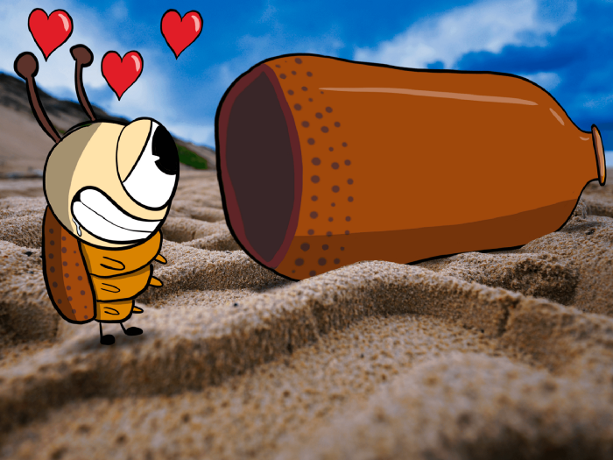
What are supernormal stimuli (3)
Exaggerated responses to existing stimuli
Evolutionary adaptation
Fixed action patterns → unlearned actions activated by internal release mechanisms, rigid, predictable (Tinbergen, 1951)
Generalization → reactions to novel stimuli different than familiar ones where reactions are known (Ghirlanda, 2002, p. 389)

Slide 6
Supernormal stimuli in humans
Sex
Food
Danger
Television and social media
Evolutionary mismatch → we are able to bypass natural instincts using cognitive overrides, but weaknesses can be exploited using technology
Why?
It generates profit

Slide 7
Sex
Cues to fertility that men are attracted to:
Women: enlarged breasts, eyes, lips, accentuated hourglass form, more body fat, young age
Cues to fertility and long-term survival that women are attracted to:
Men: height, strength, less body fat, broad shoulders, social status, wealth
Marketable:
Make-up for eyes and cosmetics for face
Cosmetic surgery (breast augmentation, liposuction)
Gym-related – supplements, steroids
Instagram filters to change features

Slide 8
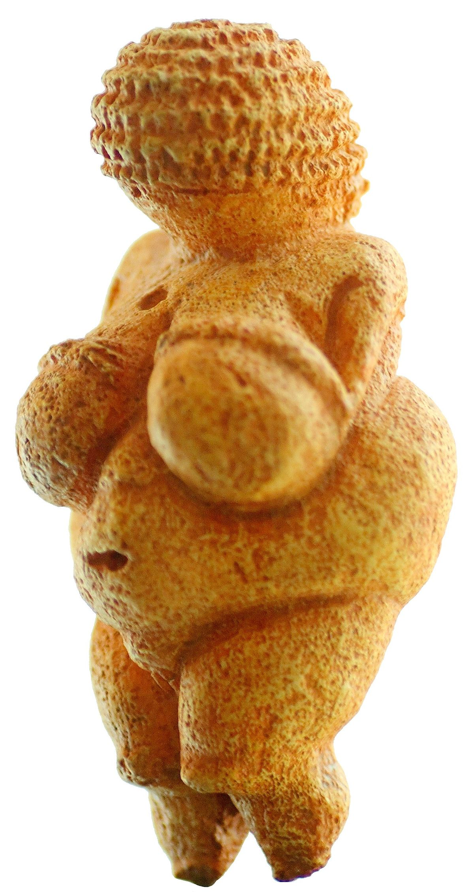
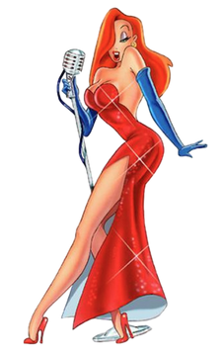
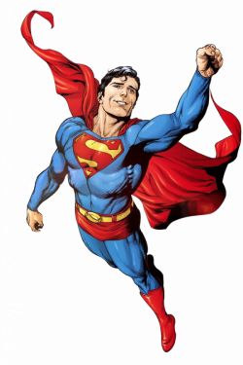

Sex
Venus of Willendorf
cca. 25000 BC
Jessica Rabbit
Superman
https://bigthink.com/health/sexual-cartoons-are-supernormal-stimuli/

Slide 9
Food
We enjoy strawberry cheesecake, but not because we evolved a taste for it. We evolved circuits that gave us trickles of enjoyment from the sweet taste of ripe fruit, the creamy mouth feel of fats and oils from nuts and meat, and the coolness of fresh water. Cheesecake packs a sensual wallop unlike anything in the natural world because it is a brew of megadoses of agreeable stimuli which we concocted for the express purpose of pressing our pleasure buttons. (Pinker 1997, 524)

Slide 10
Food
Evolutionarily, we seek high fat and sugar foods (hard to find)
High sugary foods → short-term bouts of energy (ripe fruit)
High fat foods → associated with protein and energy storage
Preference for colored and attractive foods that denote ripeness
Harrison and Marske (2005):
“Convenience/fast foods and sweets comprised 83% of advertised foods. Snacktime eating was depicted more often than breakfast, lunch, and dinner combined. Apparent character body size was unrelated to eating behavior. A 2000-calorie diet of foods in the general-audience advertisements would exceed recommended daily values (RDVs) of total fat, saturated fat, and sodium. A similar diet of foods in the child-audience advertisements would exceed the sodium RDV and provide 171 g (nearly 1 cup) of added sugar.”

Slide 11
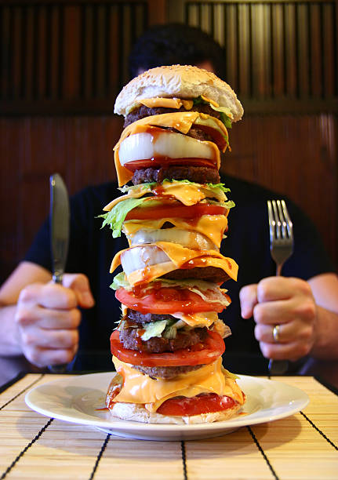
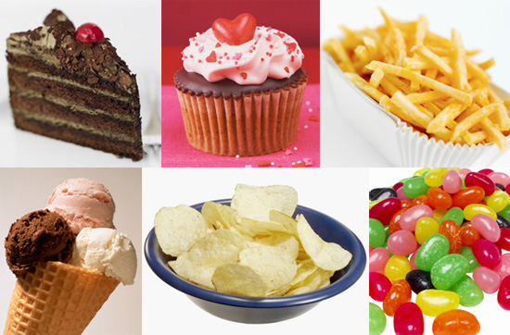
Food
https://twitter.com/i/status/1546816541567913984
https://www.youtube.com/watch?v=MflT0I7ZPCs

Slide 12
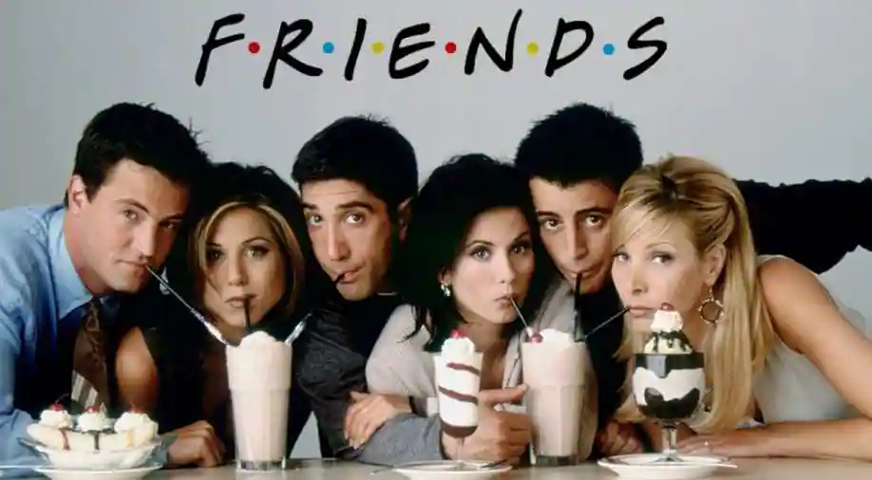
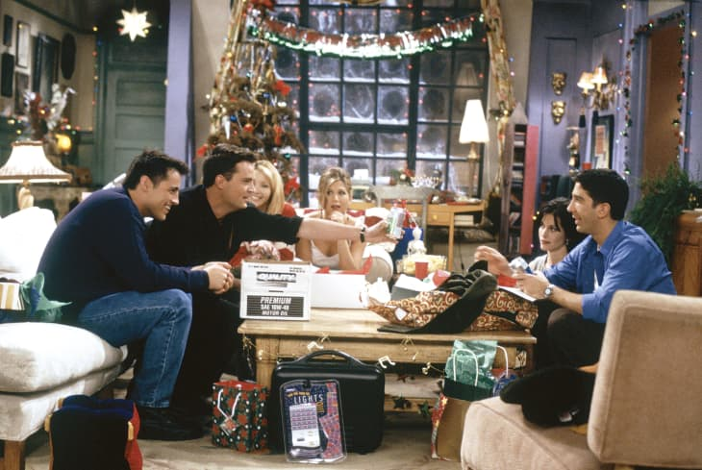
Television
Sitting in your living room seeing their living room → looking at smiling faces and people making cute jokes and laughing — all without you having to do any effort whatsoever. (Barrett, 2010)
Coziness, familiarity, safety → neurochemical responses without effort or cognitive load
What is the evolutionarily normal state for which these features are SNS?

Slide 13
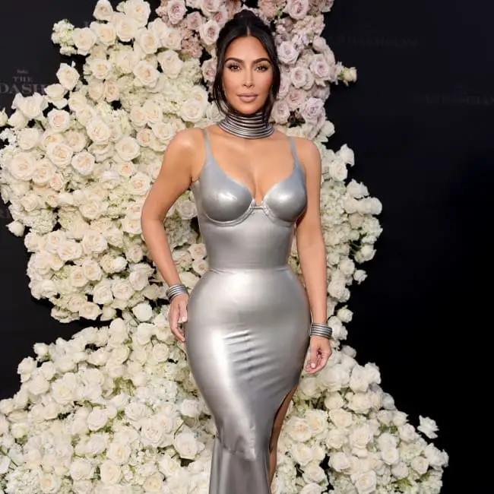
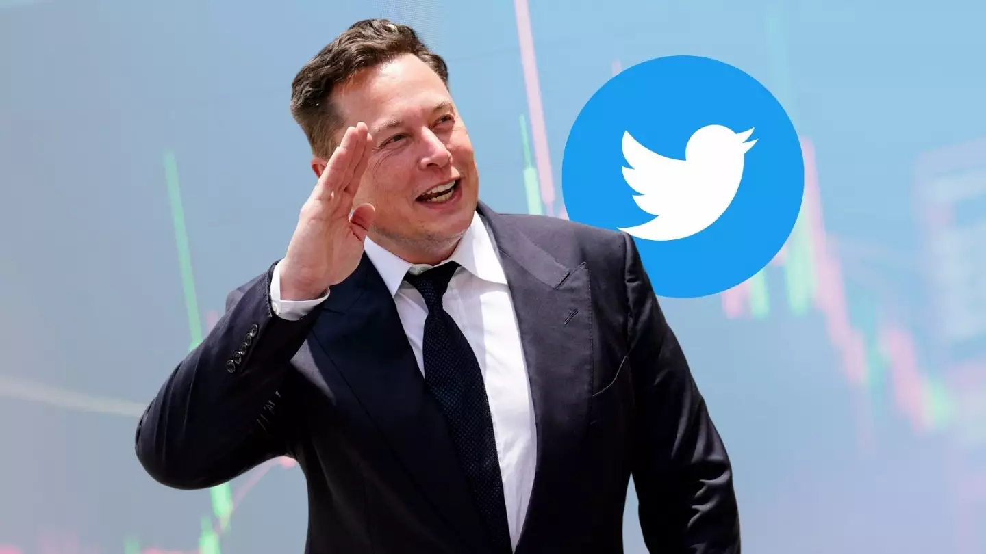



Social media
Influencers
Online platforms leveraged dopamine responses making them addictive → Like button or Short videos with easy to digest and funny information
Feeling of belonging to groups → social integration as evolutionary cue for survival

Slide 14

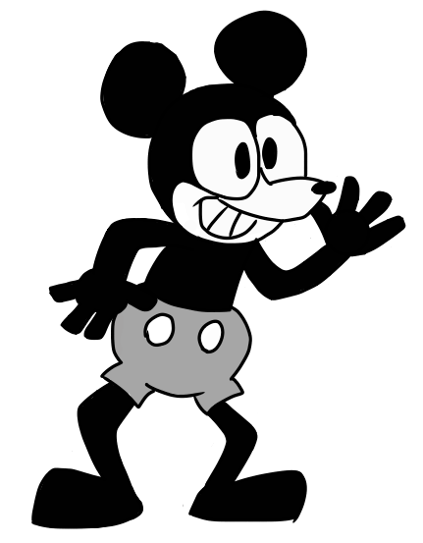
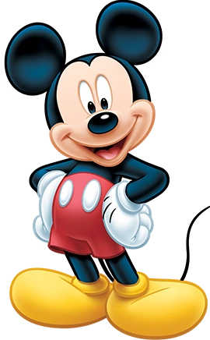
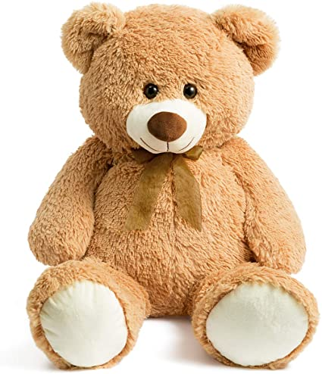
Cultural and religious influences?
Religion in itself as SNS (Lightner and Hagen, 2022)
Western vs. Eastern cultures, but lacking data (De Block and Du Laing, 2010)
Supernormal cuteness

Slide 15


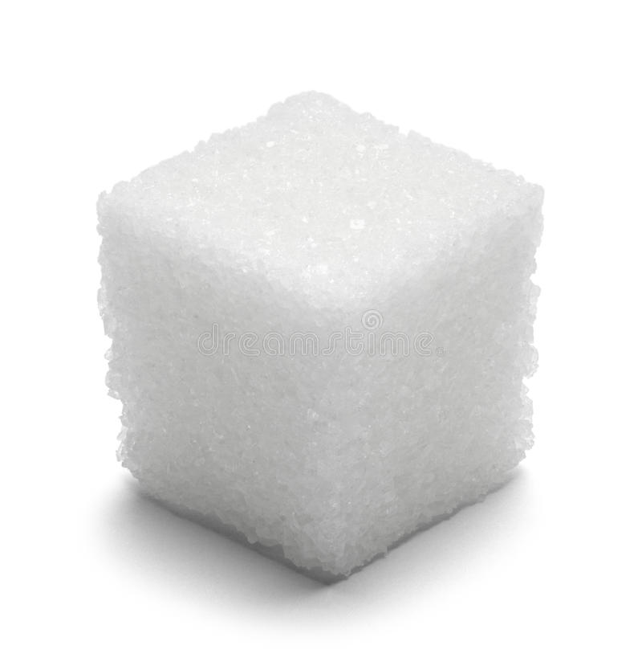
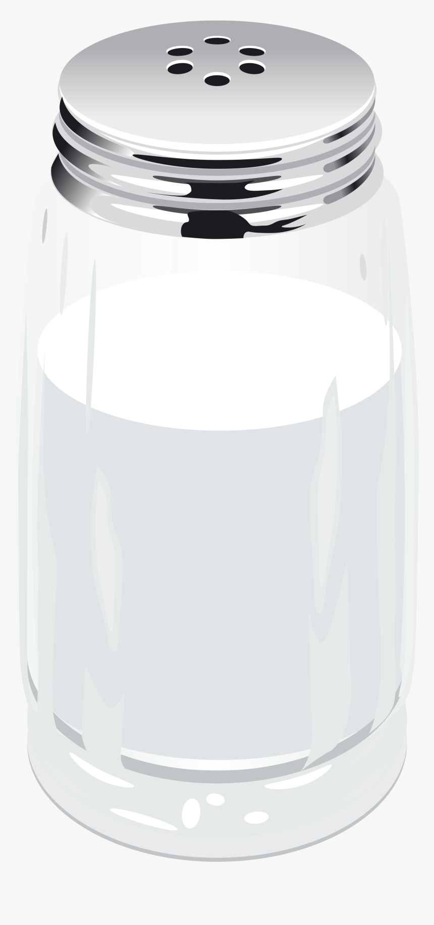
Peak-shift effect and SNS
S+ only
Both S- and S+
Lynn et al. (2010) Encyclopedia of Animal Behavior

Slide 16
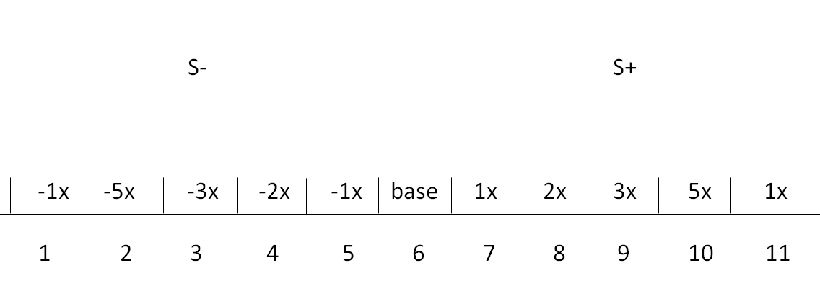
Peak-shift effect and SNS
Re-arrangement dimensions → object shape, orientation or location
Intensity dimensions → intensity of sound, color, light or other
Ghirlanda and Enquist (2003)

Slide 17
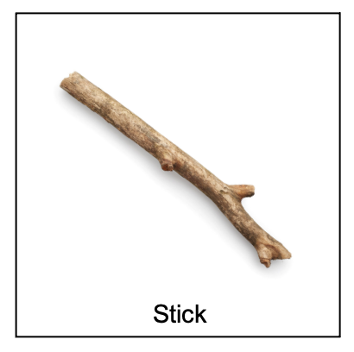
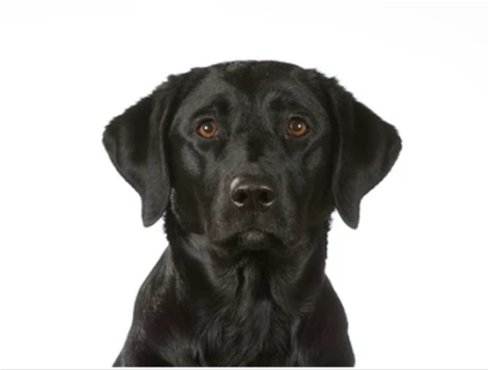
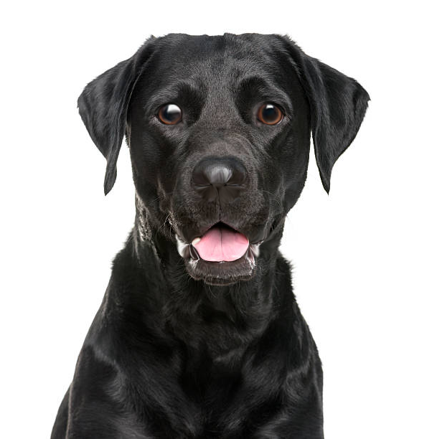
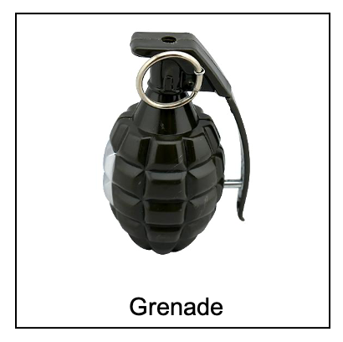
Experiment – peak-shift effect

Slide 18

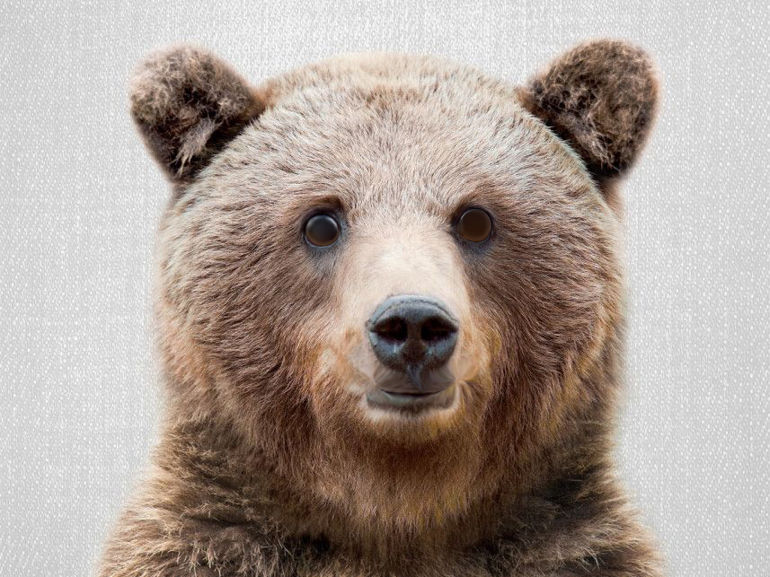
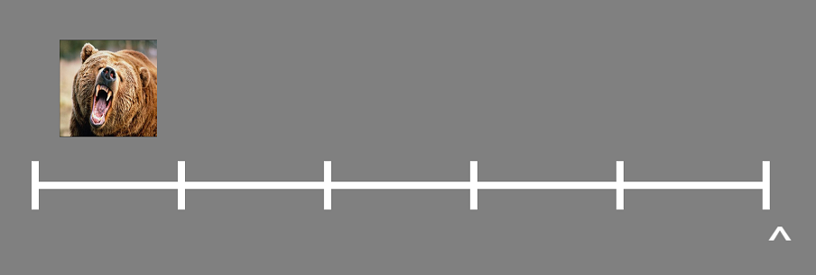
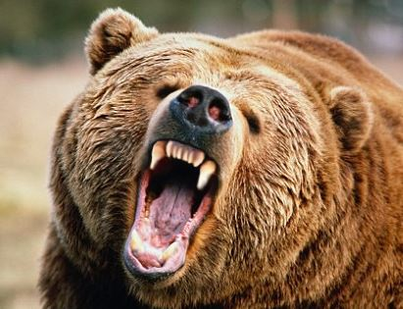
Peak-shift effect → training S+ and S-

Slide 19
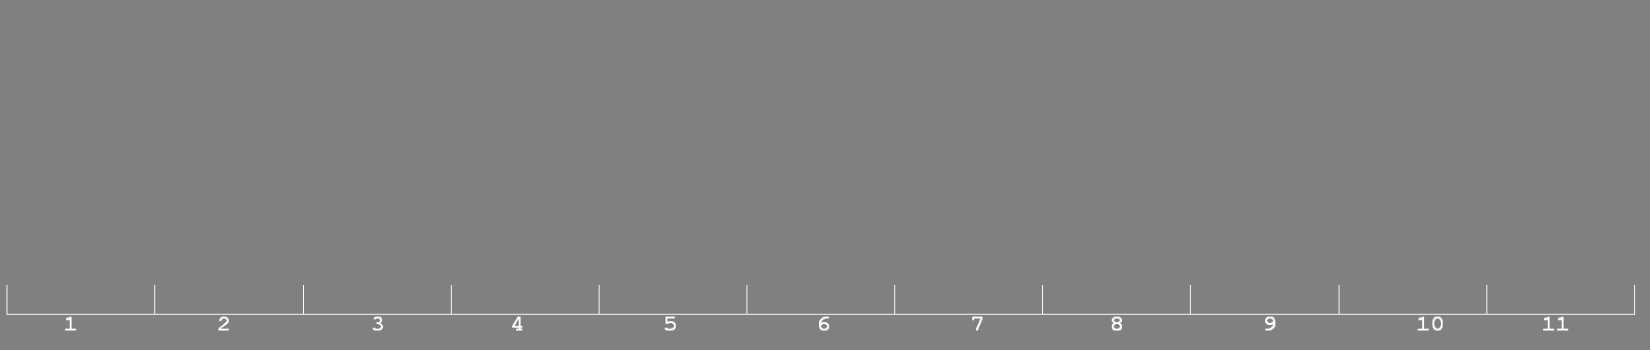
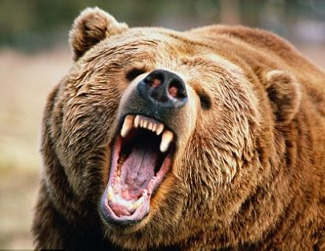

Peak-shift effect → testing S+ and S-

Slide 20
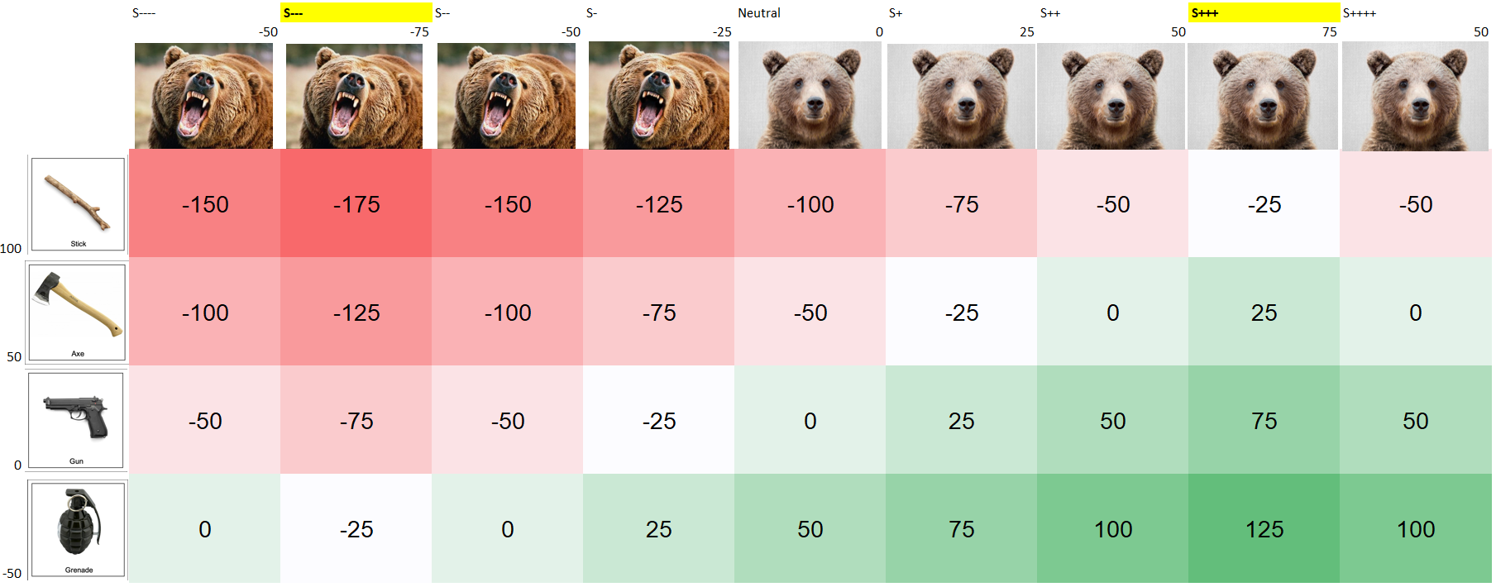
Peak-shift effect – testing
Ideas for a morphable weapon from mild to dangerous?

Slide 21
Ideal graphs
No discriminating, training and testing on S+ side
Discriminating, training and testing on S+ and S- side

Slide 22
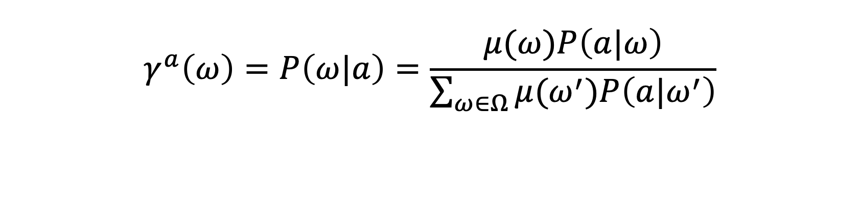
Rational inattention
$$γ^{a}\left(ω\right)=P\left(ω|a\right)=\frac{μ(ω)P\left(a|ω\right)}{\sum_{ω∈Ω}{μ(ω^{′})P\left(a|ω^{′}\right)}}$$
Likelihood function can contain behavioral and biometric data for estimating updated beliefs using a 2SLS stage (as per Dean and Neligh (2022), appendix A4, pag. 85.
Posterior weight needs to fall outside the null region for the null to be rejected in 95% of cases, after updating with data from parameter space.
Prior is uniform in conditioning

Slide 23
Way forward
Online experiment on safety vs. threat
Eye-tracking
fMRI experiment
Include other paradigms – food or social media ?

Slide 24
Thank you

